Slide 1
Final report template for web technology course Project title: online restaurant management system – Case of Final Year Project, Department of Computer and Software Engineering – SoICT, UR Submitted by: 221002036 Year 2, CSE Academic year 2022-2023

Slide 2
Table of contents
Introduction
Methods and methodologies
System analysis and design
System design
System implementation
conclusion
End

Slide 3
1. Introduction
Project summary
The Online Food Ordering platform's main purpose is to maintain track of information such as Item Category, Food, Delivery Address, Order, and Shopping Cart. It keeps track of information about the Item Category, the Customer, the Shopping Cart, and the Item Category. Only the administrator gets access to the project because it is totally built at the administrative level. The project's purpose is to develop software that will cut down on the time spent manually managing Item Category, Food, Customer, and Delivery Address. It saves the Delivery Address, Order, and Shopping Cart information

Slide 4
1. Introduction
Problem statement
The problems restaurants face in these days are
- Long journey travelled by customers to get food to the restaurant
Long lines
Difficult means of payment
Email subscription
To solve this problem we have come with an online restaurant management system to solve those problems here the users/ clients will not have travel long distances to get to the restaurants to get food, where we will provide online food delivery system.
And also by providing online delivery it will solve lines in the restaurant. We will provide an email subscription program in order to update our clients about changes about or restaurant. For the means of payment we will include simple means of payment like mobile money, airtell money, spenn.

Slide 5
1. Introduction
objectives
The main objective of this project is to manage all the information about Item Category, Customer, Shopping Cart and food delivery.

Slide 6
1. Introduction
Benefits of the project
-making ordering process easier
-efficient customer and order management
-great reach

Slide 7
2. Methods and methodologies
The first time when I came up with these idea, I remember I went to the restaurant to eat and there was a long line and I was in hurry. What's more I was from far away from home. That’s why I thought how I can build a system where that will allow someone to make order online without leaving home.

Slide 8
2. Methods and methodologies
Tools to be used
Software tools
.visual studio code
.xamp
.chrome browser
Hardware tools
.laptop

Slide 9
3. System analysis and design
Requirement specifications
System user Requirement
Functional Requirement
Data Requirement
Security requirements

Slide 10
Requirements specifications
System user Requirement
-TARGETED USERS ARE:
.CUSTOMERS
.MANAGERS
. KITCHEN CHIEFS

Slide 11
Requirements specifications
Functional Requirement
-Fill in the required forms
-Validating data
-Submit data

Slide 12
Requirements specifications
Data Requirement
Data needed are:
-customer details(names, email, address, username and paswword)
Food details
Menu detail(dish name)

Slide 13
takes
order
gives
customer
manager
manages
Name of food
makes
Menu detail
store
Food info
menu
status
status
delivery
payment
ERD DIAGRAM

Slide 14
Requirements specifications
Security Requirement
-Customers can access menu but the can’t change it
-customer will have first to log in before making an order

Slide 15
4. System design
sitemap
HOME
LOGIN
SIGN UP
ABOUT US
clients
admin
Manage products
Manage orders
Manage users
logout
MANAGE PROFILE
ACCESS MENU
LOGOUT

Slide 16
System flow chart
clients
managers
home
home
login
login
Landing page
orders
buy
Confirm order
order
payment

Slide 17
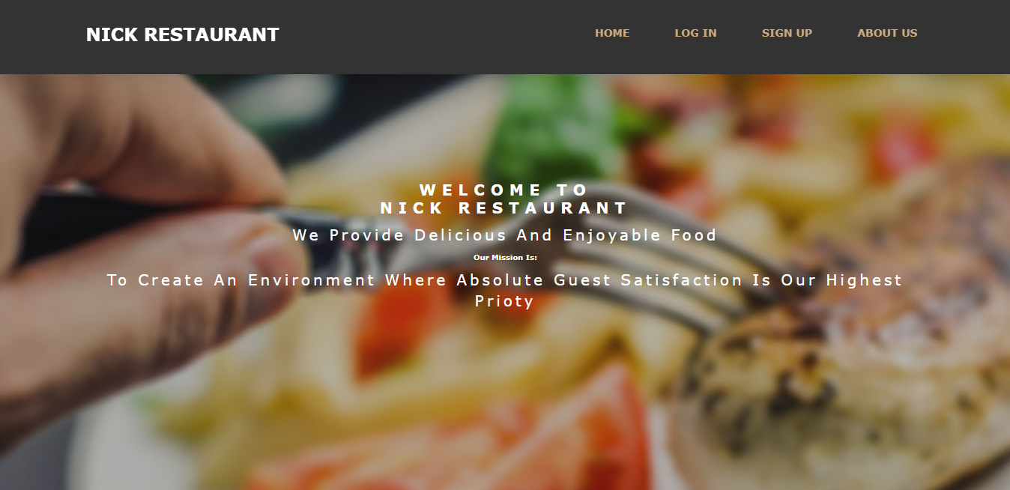
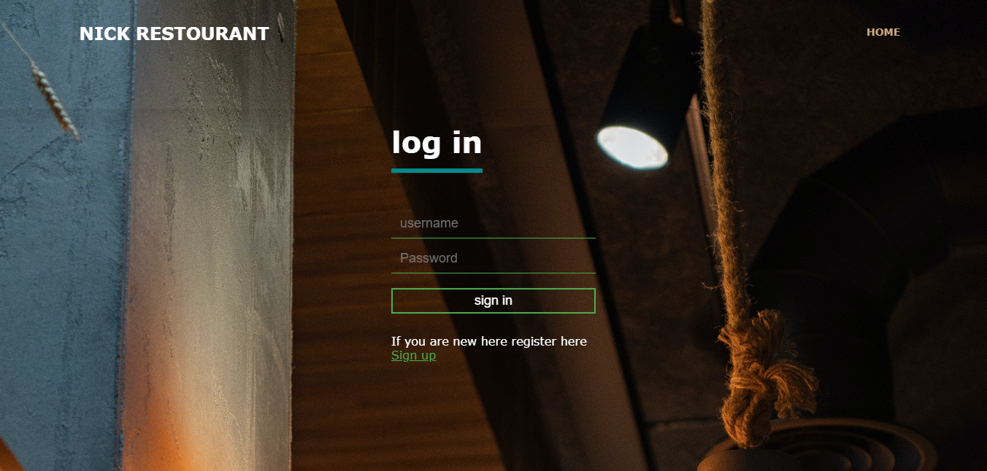
5. System implementation
Home page
login

Slide 18
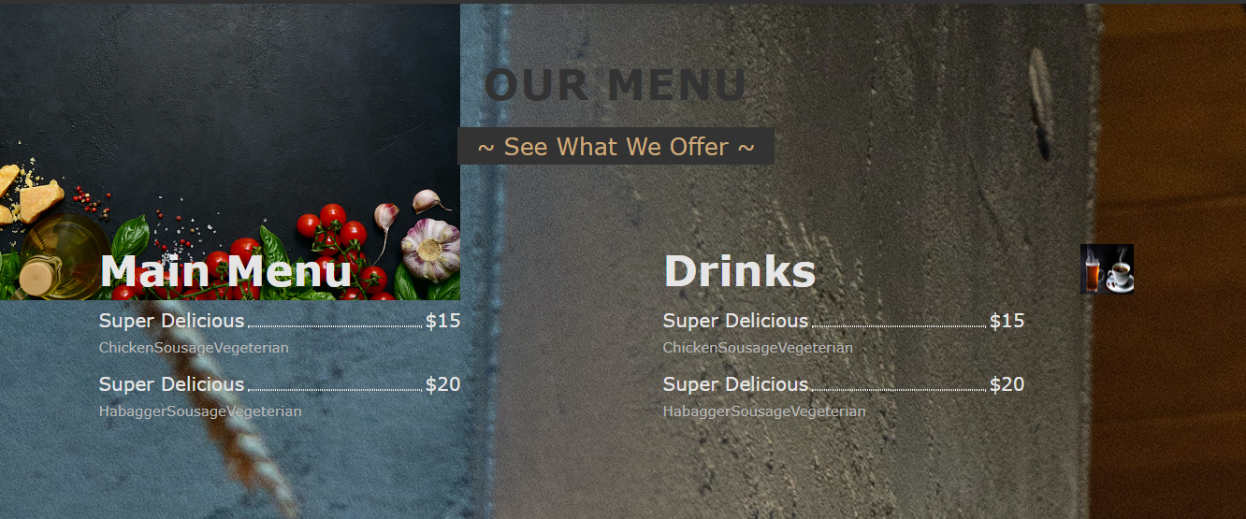
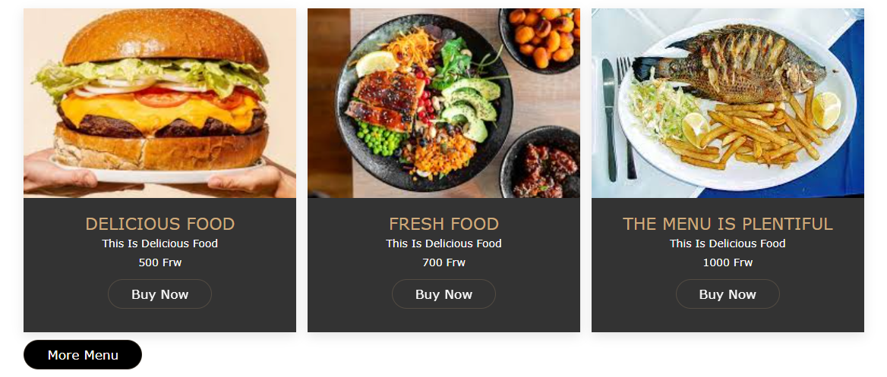
menu

Slide 19

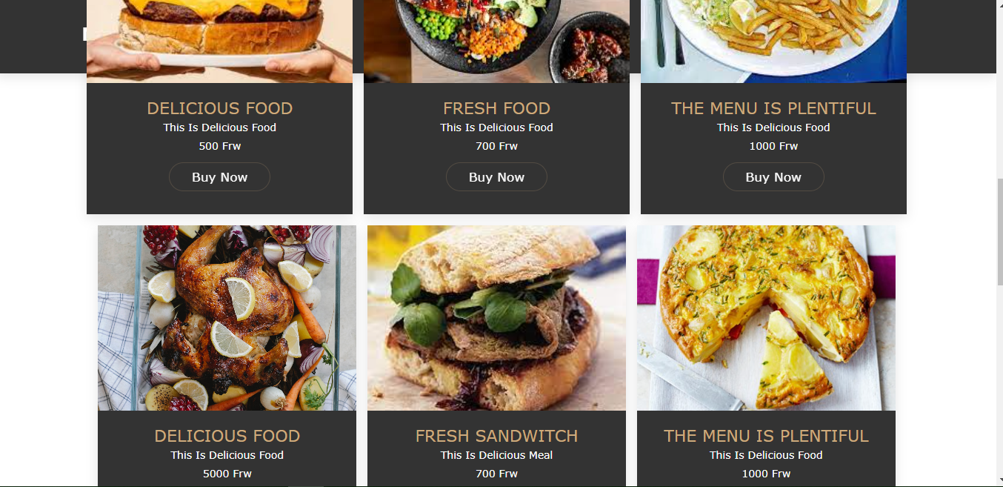
Landing page after a user log in

Slide 20
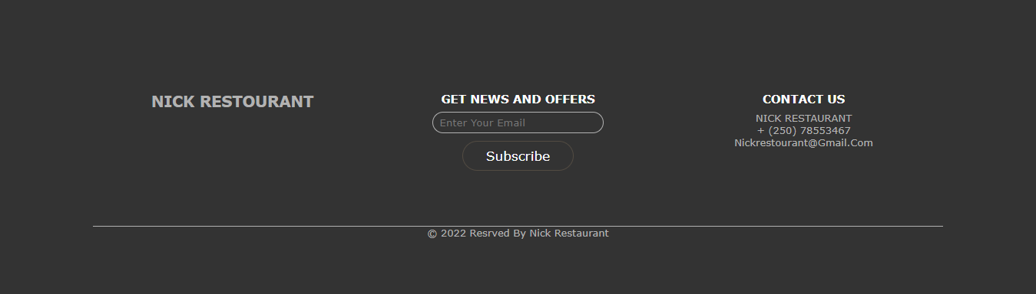
footer

Slide 21
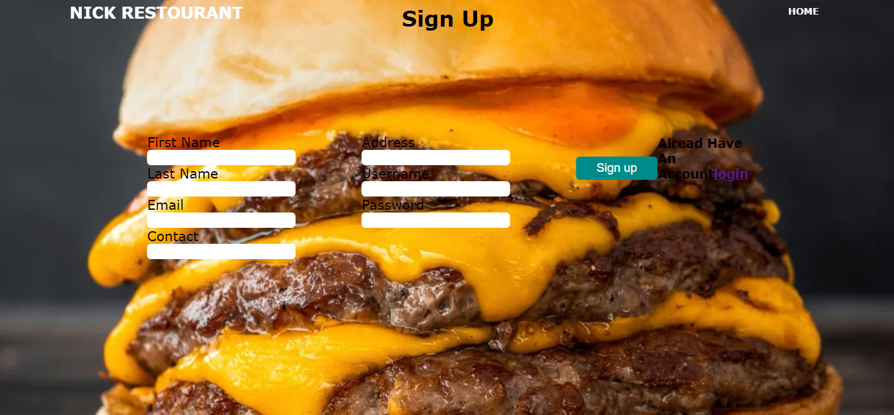
Sign up form

Slide 22
5. conclusion
I can conclude by saying that this is a good project, it will solve problems we encounter these days.
My progress is on 79%.
And I can recommend these project to
-customers
-students
-restaurant managers
Link to github
https://github.com/gashnick/nickrestourant

